Slide 1
Context Sensitive Systems – Introduction to Context Recognition

Slide 2
Supervised Machine Learning
Supervised learning
Set of training data:
Feature vectors , and labels
Features calculated at end of each sample window, resulting in vector
Vector is classified by classification algorithm, resulting in context label

Slide 3
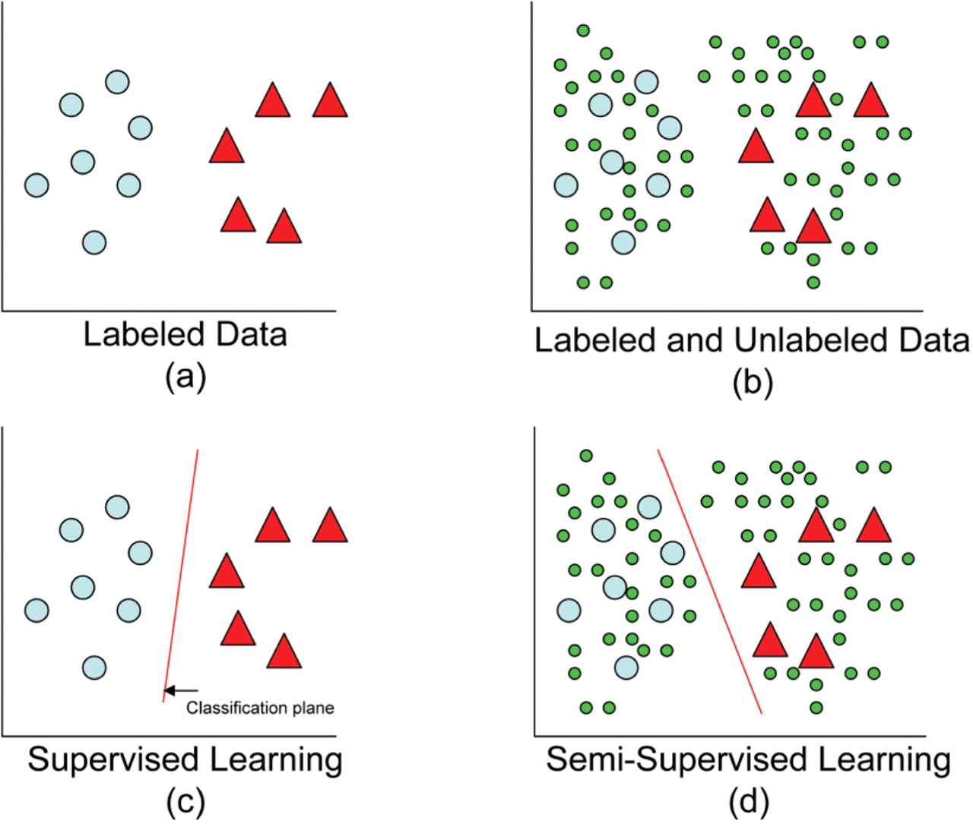
Supervised Machine Learning

Slide 4
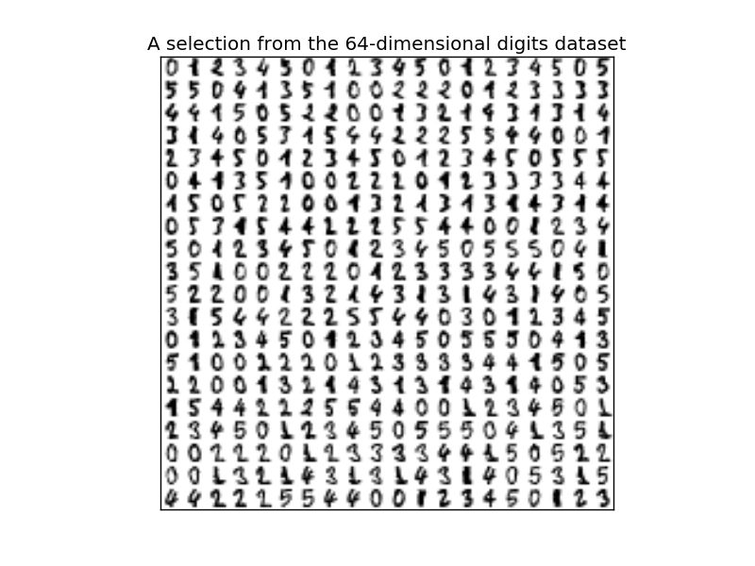
Example simple Digits Dataset

Slide 5
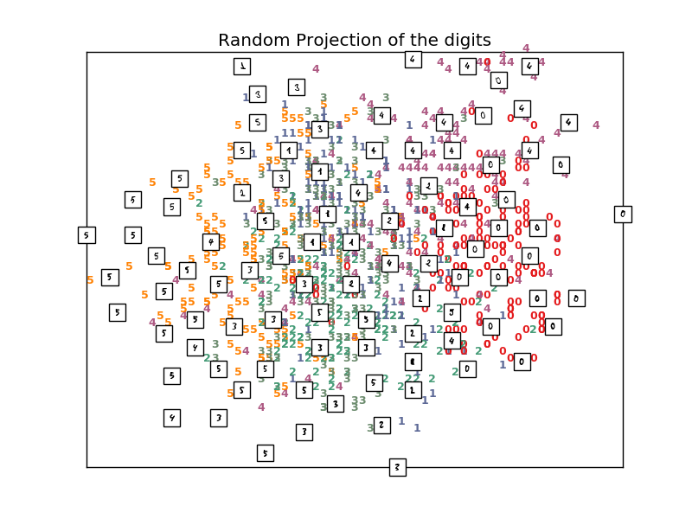
2D Representation of feature space

Slide 6
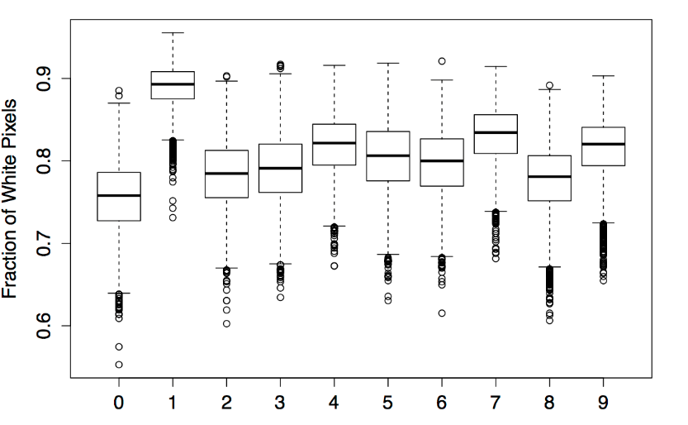
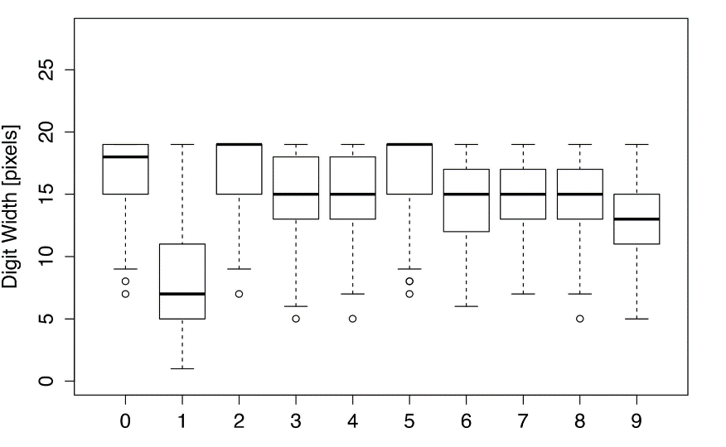
Looking at each dimension
http://bdewilde.github.io/blog/blogger/2012/10/17/classification-of-hand-written-digits-2/

Slide 7
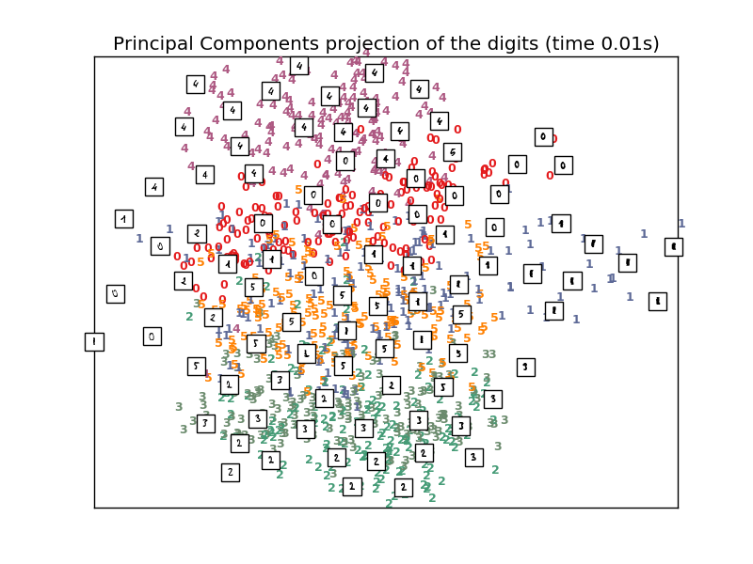
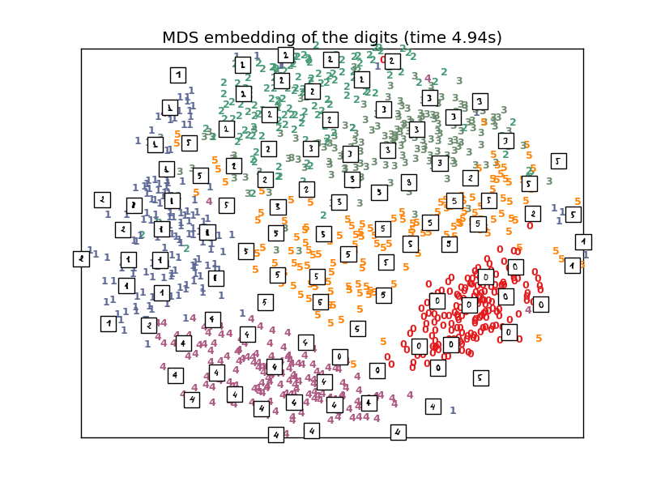
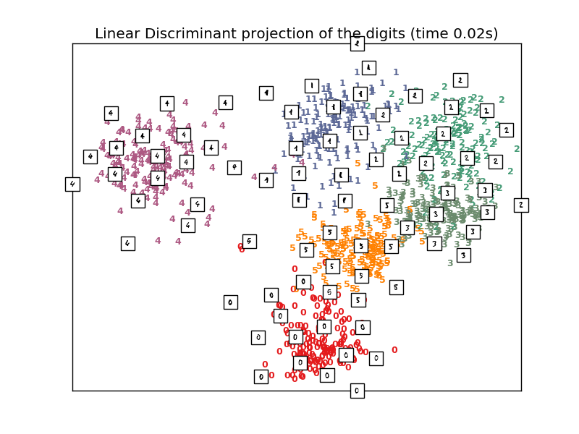
Visualizing Feature Spaces

Slide 8
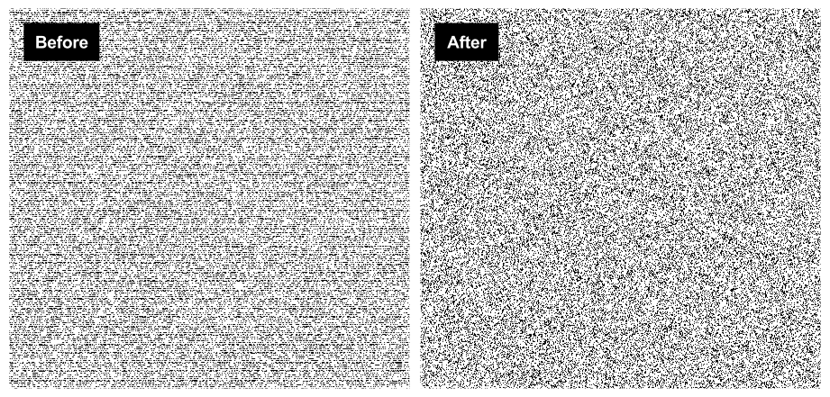
Humans are good a seeing potential patterns…
…computer can then do the task of identifying them.

Slide 9
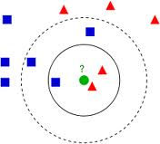

K-Nearest Neighbors
General approach – store all training vectors and labels
For each classification vector, assign a label based on the majority of the k “closest” vectors
Use a specific metric to compute distance between vectors, most often Euclidean distance
Others: Manhattan, Hamming, Mahalanobis
Simple to implement!
Storing vectors in tree structures reduces search for k neighbors
Relatively low recognition rates, susceptible to normalization
kNN is “lazy” – all computational intensity occurs as classification time
High memory consumption due to vector storage
Bad news bears for embedded systems

Slide 10
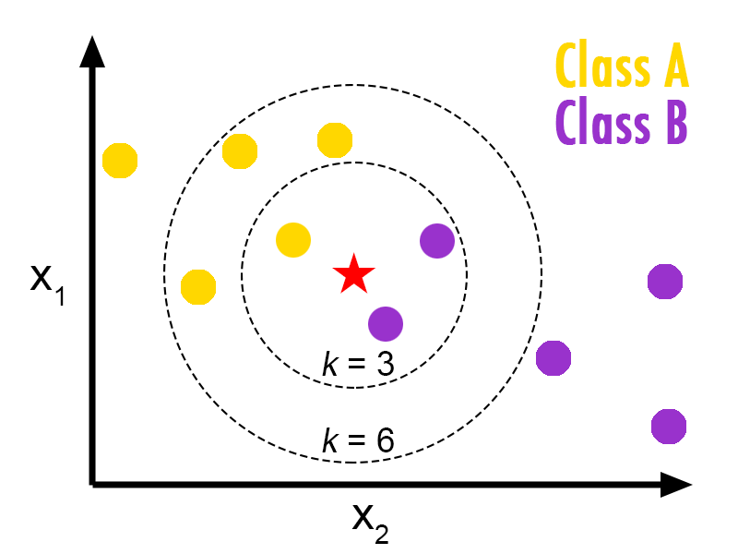
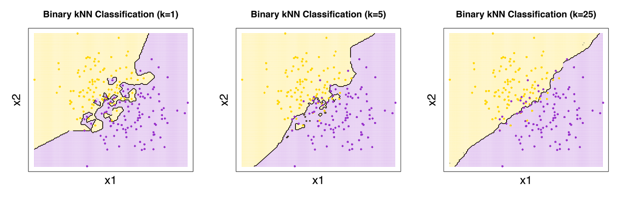
Example KNN
Source:http://bdewilde.github.io/
Why is KNN interesting for Big Data?

Slide 11
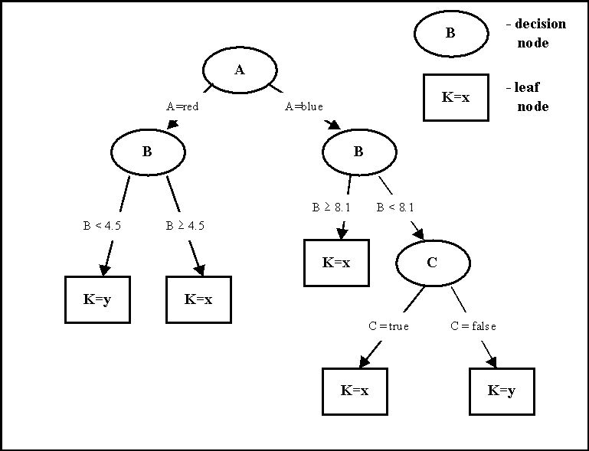

C4.5 Decision Tree
General approach – model data as a tree such that nodes are decisions (splits) over elements of and leaves are label assignments
Following decisions for each vector should lead to a correctly labeled leaf
Construction: at each node, calculate the Shannon entropy over labels for splitting based on feature
Split on the feature with greatest reduction in confusion
Continue until further splits do not reduce entropy “much”
Further optimizations such as “pruning” can improve tree structure
Simple IF/THEN structure makes execution embedded execution interesting
Tree depth only bounded by number of training vectors, one leaf per vector!

Slide 12
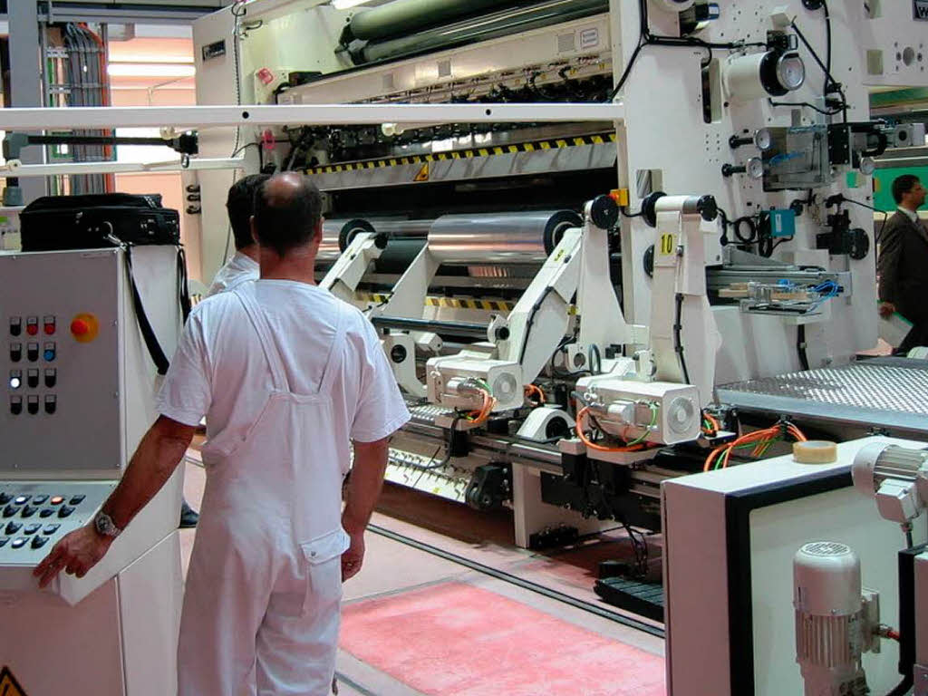


Slide 13
Example CSS Problems
Predict best time for cleaning and maintenance
Alarm a worker when untypically parameters are used
Transfer best-practices from product A to product B
Reverse engineer human knowledge
Correct ERP information based on sensors (really maintenance? , really the same product?)
→ Challenge different materials and production

Slide 14
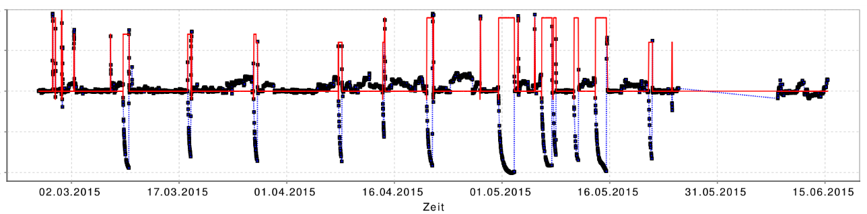
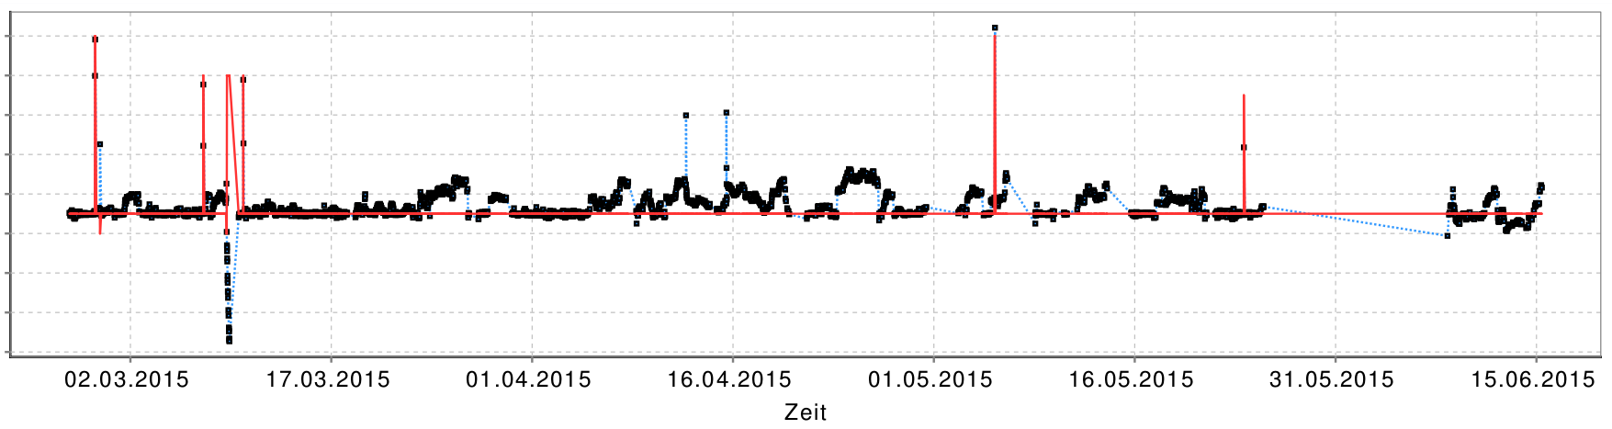
Example: Decision Tree for Film Production
Segmentation based on ERP und MES data (what was produced)
Gather discriminating parameters
If we are producing this the parameter a are typically in [x…y]

Slide 15

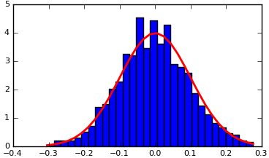


Naïve Bayes
General approach – learn how data is distributed probabilistically and use this to infer context
Learn probability density for
sensor data given each activity
Bayes’ theorem
Using this, calculate probability of a class given sensor data
Generally – surprising good results, low computational complexity for classification
Naïve – assumes uncorrelated data
Over-simplification of the prior

Slide 16
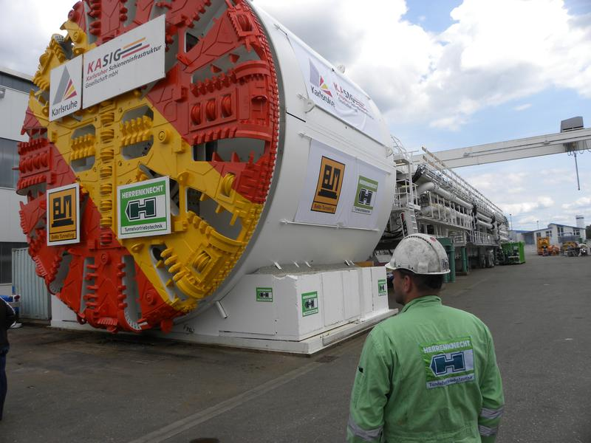

Analyzing of production of drilling machines
AVO
FAUF
BS
JOIN + FILTER + GEN
KOSTEN
QS
RF
Better predicting cost and time for producing unique machinery
Notes:
BS: Aggregiert auf Aufträge (außer bei Liegezeituntersuchung)
One-hot-Kodierung von Arbeitsplätzen die in mehr als 1% der Unteraufträge vorkommen
Filtertung: Entfernen irrelevanter Attribute: leere Spalten, etc
Groundtruth Leakage eindämmen (Ids entfernen)
Entfernung von Ist* Attributen (Attribute die erst nach Durchführung bekannt)
Einführung neuer Attribute (z.B. Plan-Delta)

Slide 17
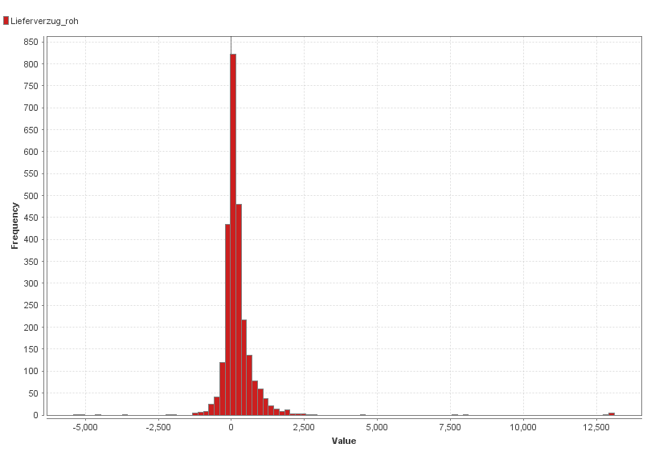
Predicting delivery delays
Planned time vs. actual
36% on or before time
64% after planed time
Looking at distribution there one could imagine a systematic error
850
-5000 h
0 h
12500 h
Distribution of delay
Notes:
Die dargestellten und zur Vorhersage genutzten Attribute stellen eine Teilmenge der Attribute dar die ursprünglich getestet wurden

Slide 18
Analyzing with naive bayes
 | true Kein Lieferverzug | true Lieferverzug | class precision
pred. Kein Lieferverzug | 243 | 261 | 48.21%
pred. Lieferverzug | 668 | 1377 | 67.33%
class recall | 26.67% | 84.07%
The following variables increase the probabilty of delay!
Sum(SMG1) = 0, Sum(STA) = 1, Plan_Delta < 500h, Sum(BR10) = 1, Sum(S4) = 0
84% of delays can be predicted with 67% accuracy
Context Sensitive System: Trigger process changes on delay
Notes:
Die dargestellten und zur Vorhersage genutzten Attribute stellen eine Teilmenge der Attribute dar die ursprünglich getestet wurden
Mögliche Handlungsanweisung
Verbesserungen:
Größere Datenmenge; genauere Aufschlüsselung nach Lieferverzugsklassen

Slide 19
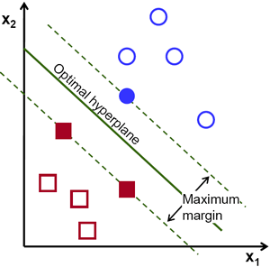
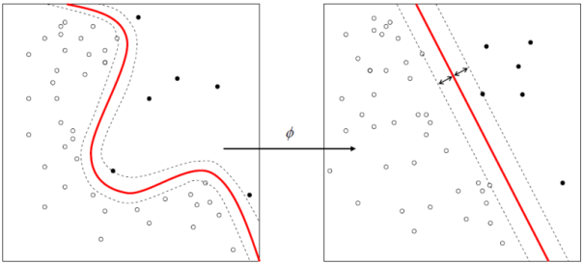
Support Vector Machines
Main idea: create hyperplanes which separate data with the highest margin
Finding optimal hyperplane is convex constraint optimization problem
Kernel trick for non-linear class.
Increase dimensionality with transform
Allows linear classification
Advantage
High accuracy
Easily interpretable – as opposed to ANN
Accuracy not affected by high dimensions
Disadvantage
High memory consumption
Prone to overfitting
Sensitive to noise
Choice of kernel function and parameters critical

Slide 20
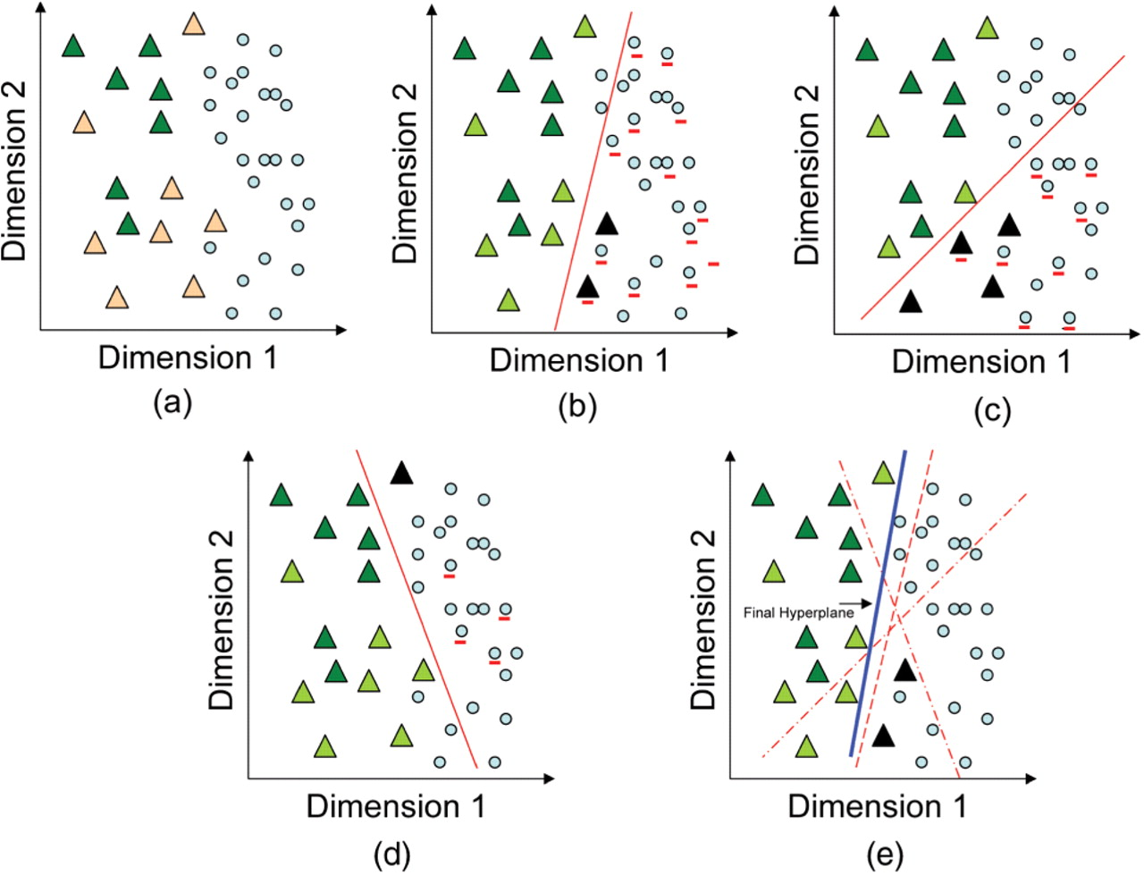

Internal operation of the SVM-HUSTLE algorithm represented in two dimensions.
Shah A R et al. Bioinformatics 2008;24:783-790
© The Author 2008. Published by Oxford University Press. All rights reserved. For Permissions, please email: journals.permissions@oxfordjournals.org
Notes:
Internal operation of the SVM-HUSTLE algorithm represented in two dimensions. The triangles represent the homologs of a query sequence while the dots are the unlabeled data samples. Depending on the initial set of positive examples (dark green) and randomly selected negative examples (triangles and dots underlined in red) a hyperplane can be drawn in any of the three positions as illustrated in the figure. Figure (A) represents the data that is considered linearly separable in space after kernel transformations. Figures (B), (C) and (D) are examples of a hyperplane in two-dimensional space that separates the data based on separate random selection of the negative class. In each of these figures, the black triangles represent incorrectly classified data, the lime green triangles are correctly classified based on the hyperplane selection and the red underlined black triangles are true homologs recruited by chance as a negative training example. Figure (E) shows the final classification (hyperplane in dark blue) after taking the average of the other three hyperplanes illustrating the necessity of averaging the classifiers.

Slide 21
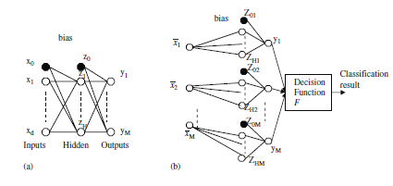
Artificial Neural Networks
General approach – create a network of neurons consisting of weights and thresholds which iteratively minimize a cost function
Input neurons for each feature, output neurons for each class
Two general approaches:
One neural network with an input for each feature and output for each class (a)
A single network for each class, with inputs for each feature a one binary output for that class (b)
Finally: decision function block converts ANN output to classification
Only broad heuristics available for how many neurons are needed for accuracy
Guobin Ou, Yi Lu Murphey, Multi-class pattern classification using neural networks

Slide 22
Training and Testing
Goal: “Predict” the realistic error of a classifier
REMEMBER: we must know the classification (class attribute values) of all instances (records) used in the test procedure (supervised)
Predictive Accuracy Evaluation

Slide 23
Error Rate
Positives: instance (record) class is predicted correctly
Negatives instance class is predicted incorrectly
Accuracy: proportion of correct classifications made over the whole set of instances (records) used for testing
Example:
Testing Rules (testing instance #1) = instance #1.class - Positive
Testing Rules (testing instance #2) not= instance #2.class - Negative
Testing Rules (testing instance #3) = instance #3.class - Positive
Testing Rules (testing instance #4) = instance #4.class - Negative
Testing Rules (testing instance #5) not= instance #5.class - Positive
Accuracy: 3/5=60%

Slide 24
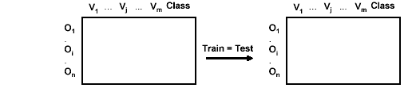
Resubstitution (N ; N)
Testing the classification model by using the given data set (already used for „training“)
does the code work at all?
see if the model/function can be approximated
particularly look at effect of model complexity

Slide 25
Resubstitution Error Rate
Error rate is obtained from training data
NOT always 0% error rate, but usually very low!
We hopefully have some assumptions based on the knowledge of the algorithm and the data quality.
Resubstitution error rate indicates only how good (bad) are our results (rules, patterns, NN) on the training data

Slide 26
Why not always 0%?
The error/error rate on the training data is not always 0% because algorithms involve different (often statistical) decisions.
The features not clearly discriminate a class, even for the perfect classifier (nicht injectiv)
It is used for “parameters tuning”
The error on the training data is
NOT a good indicator of performance on future data
it does not estimate the effect of any not yet seen data
How to solve it:
Split data into training and test set

Slide 27
Why not always 0%?
Choice of Performance measure:
Number of correct classification (training error rate) the lower, the better
Predictive Accuracy Evaluation (test error rate) also, the lower, the better
BUT (N:N) re-substitution is NOT a predictive accuracy bevause resubstitution error rate = training data error rate

Slide 28
Training and test set
Test set should be independent instances that have played no part in formation of testing rules
Assumption: both training data and test data are representative samples of the underlying problem as represented by our chosen dataset.

Slide 29
Training and test set
Training and Test data may differ in context parameters
Example:
Testing rules are built using user data from two different countries A and B
We estimate performance of classifier
from country A (not really classifier yet – obtained rules only) we test it on data from country B, and vice-versa

Slide 30
Training and test set
It is important that the test data is not used in any way to create the testing rules
In fact, learning schemes operate in two stages:
Stage 1: build the basic structure
Stage 2: optimize parameter settings; can use (N:N) re-substitution. The test data cannot be used for parameter tuning!
Also the you are a (hopefully) learning!
Proper procedure uses three sets: training data, validation data and test data
Validation data is train data is used as test data for parameter tuning, not the actual test data!

Slide 31
Training and testing
The larger is the training the better is the classifier
The larger the test data the more accurate the error estimate
The error rate of Resubstitution (N;N) can tell us ONLY whether the algorithm used in the training is applicable or not
Dilemma: ideally both training and test set should be large! What to do if the amount of data is limited?
How to split?

Slide 32
Holdout (2N/3 ; N/3)
The holdout method reserves a certain amount for testing and uses the remainder for training – so they are disjoint!
Usually, one third for testing, and the rest for training
Train-and-test; repeat
Or better Train-validate-tune-train-validate-…-test
Once complete all data can be used to build final classifier (reality is your test)

Slide 33
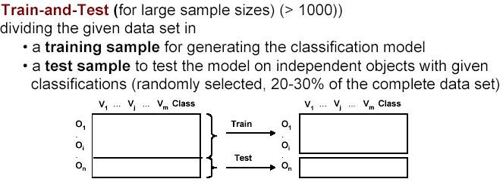
Holdout

Slide 34
Repeated Holdout
Holdout can be made more reliable by repeating the process with different sub-samples:
1. In each iteration, a certain proportion is randomly selected for training, the rest of data is used for testing
2. The error rates on the different iterations are averaged to yield an overall error rate
Repeated holdout still not optimum: the different test sets overlap

Slide 35
x-fold cross-validation (N-N/x ; N/x)
cross-validation is used to prevent the overlap!
cross-validation avoids overlapping test sets:
first step: split data into x subsets of equal size
second step: use each subset in turn for testing, the remainder for training
The error estimates are averaged to yield an overall accuracy estimate

Slide 36
Cross-validation
Standard cross-validation: 10-fold cross-validation
Why 10?
Extensive experiments have shown that this is the best choice to get an accurate estimate.
There is also some theoretical evidence for this. So interesting!

Slide 37
Improve cross-validation
Even better: repeated cross-validation
Example:
10-fold cross-validation is repeated 10 times and results are averaged (reduce the variance)

Slide 38
A particular form of cross-validation
x-fold cross-validation: (N-N/x ; N/x)
If x = N, what happens?
We get:
(N-1; 1)
It is called “leave –one –out”

Slide 39
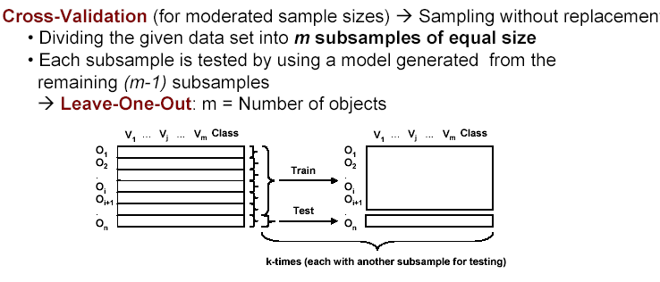
Leave-one-out (N-1 ; 1)

Slide 40
Leave-one-out (N-1 ; 1)
Leave-one-out is a particular form of cross-validation:
we set number of folds to number of training instances, i.e. x= N.
For n instances we build classifier
(repeat the testing) n times
Error rate= success instances predicted/ n

Slide 41
Leave-one-out Procedure
Let C(i) be the classifier (rules) built on all data except record x_i
Evaluate C(i) on x_i, and determine if it is correct or in error
Repeat for all i=1,2,…,n.
The total error is the proportion of all the incorrectly classified x_i

Slide 42
Leave-one-out (N-1 ; 1)
Make best use of the data
Involves no random subsampling
Stratification is not possible
Very computationally expensive
MOST commonly used

Slide 43
Selecting classifiers
Frequent question: which of two learning schemes performs better?
Obvious way: compare 10fold CV estimates
Generally sufficient in applications (we don't loose if the chosen method is not truly better)
However, what about machine learning research? Proof?

Slide 44
Showing improvement
Sample infinitely many dataset of specified size obtain CV estimate
Check if mean accuracy for scheme A is better than for scheme B
In practice we have limited data and a limited number of estimates for computing the mean:
Use a paired t- test: the individual samples are paired and the same CV is applied twice

Slide 45
Cost-sensitive classification
Classification with costs:
Basic idea: only predict high cost class when very confident about prediction
Expected cost: dot product of vector of class probabilities and appropriate column in cost matrix
Choose column (class) that minimizes expected cost

Slide 46
Cost-Sensitive Learning
Simple methods for costsensitive learning:
Resampling of instances according to cost
Weighting of instances according to costs
Some schemes can take costs into account by varying a parameter, e.g. naïve Bayes

Slide 47
Choosing a model by minimum description length
space required to describe a theory +
space required to describe the theory’s mistakes
Encoded classifier + Encoded resubmission errors
MDL principle is a model selection criterion
Also known as Occam’s Razor : the best theory is the smallest one that describes all the facts
Data compression!

Slide 48
Sources
Data Mining: Practical Machine Learning Tools and Techniques With Java Implementations (Chapter 5,7), Eibe Frank and Ian H. Witten
Data Mining: Concepts and Techniques (Chapter 7), Jiawei Han and Micheline Kamber
The Data mining course materials offered by Dr.Michael Möhring in the University of Koblenz and Landau, Germany
http://www.uni-koblenz.de/FB4/Institutes/IWVI/AGTroitzsch/People/MichaelMoehring
Pattern Recognition slide by David J. Marchette in Naval Surface Warfare Center
http://www-cgrl.cs.mcgill.ca/~godfried/teaching/pr-info.html
Anita Wasilewska ,CLassification TESTING Testing classifier accuracy

Slide 49
http://en.wikipedia.org/wiki/Cross-validation_%28statistics%29
http://www.cs.waikato.ac.nz/~tcs/DataMining/index.html

